Slide 1


Advice for New FIRST Teams
Jim Zondag
FRC Team #33
Killer Bees Robotics

Slide 2

Quote of the day
“FIRST is really, really hard……
it’s supposed to be hard.
If this were easy, then doing it wouldn’t be nearly so cool!”
- Dr. Woodie Flowers
Notes:
Topic timing:
About 10 minutes each
Introductions, who we are, about our team and team goals, slides 1-3
Recruiting, slides 4-6
Training Leadership and meeting structure slides 7-10
Team Organization and why we don’t have formal subteams. slides 11-13
Team Leadership selection criteria slide 14
Good Things – Points of Pride – slide 15

Slide 3

Zondag’s Disclaimer
Every FIRST team is different, and the methods you choose for running your team will be driven by your team’s individual situations. The ideas discussed here work well for Team #33, but your team may have different resources, constraints, demands, and opportunities.
  Key factors include:
    Money
    Facilities
    Skills
    Experience
    Number of people
    Current game challenge
None of this is static: Despite 20+ years of experience, we adjust the details of our process every year.

Slide 4













Six Keys to a Successful FIRST Team:
1. Mentors: Competent, dedicated, and inspirational leaders are at the heart of every great team.
2. School: All great teams have a strong partnership between their school and their team.
3. Students: An enthusiastic,
determined group of students makes the whole thing worth doing.
4. Supporters: Parents, teachers, alumni, and others who can help in small ways make a tremendous difference.
5. Workplace: A place to work is
very important. Without this, the project will fail.
6. Sponsors: FIRST is expensive. Every team needs sponsors in order to succeed and thrive.

Slide 5

Great People make Great Teams
A team is simply a group of people working together
towards a common goal.
Get the RIGHT people
on your team!
This is the single most important thing you can do!
Get
Stuff
Done
Think
Big
People I
want on
my team
Have Fun
Doing It

Slide 6
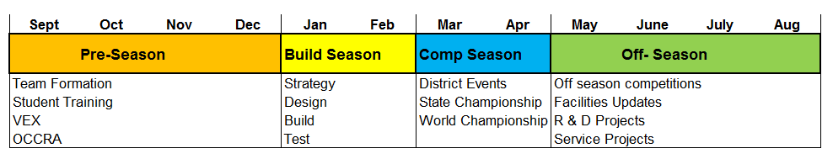

Our FRC year at a glance
FRC is NOT a 6 week project – it is a 52 week project!
– you must accept this if you want to be successful
(actually that is not true either, we have over 1000 weeks in and counting ☺)
Our team operates all year round:
Our annual calendar is broken into 4 unequal sections.
The busiest time is in the first 4 months of the year.
The official FRC season spans from roughly Jan 1 - May 1.

Slide 7
Top 10 Lists for each part of the year
Competition
  Take only what you need
  Organize
  Have a pit display
  Have a judges book
  Have a spirit leader
  Assign people you can trust to coordinate scouting
  Make a strategy for each match.
  ALWAYS make a pick list
  Be honest to other teams
  Take benchmarking photos
Post season:
  Cover lessons learned, things gone right things gone wrong
  Perform exit interviews with students
  Implement improvements and ideas
  Continue learning skills
  Fundraising should be a year round thing.
  Summer is a great time for a team party.
  Chairman’s award activities.
  Make prototypes of new ideas
  Learn new construction methods
  Restock shop and replace tools
Pre season:
  Make a detailed schedule
  Make a budget outline
  Define your organization
  Pre-order material
  Predefine standards
  Learn to make parts
  Learn computer skills.
  Benchmark others
  Recruit Mentors
  Order Uniforms
Build season
  Define a strategy and stick to it.
  Keep it simple
  Do the Math
  Build Mockups
  Make Drawings of everything
  Modularize your design
  Make spare parts
  Over-Schedule your meetings
  Test everything
  Practice, Practice, Practice

Slide 8
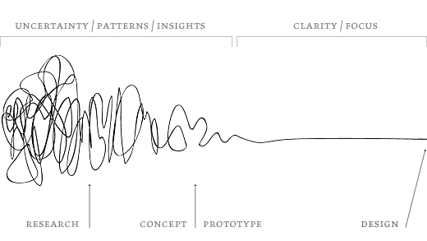
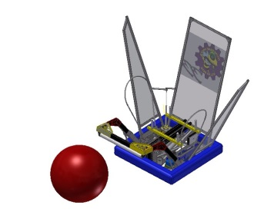
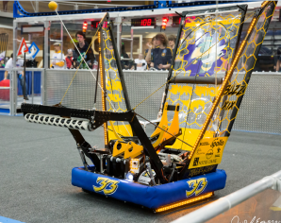
Design Process, From Chaos to Order
45 Days

Slide 9
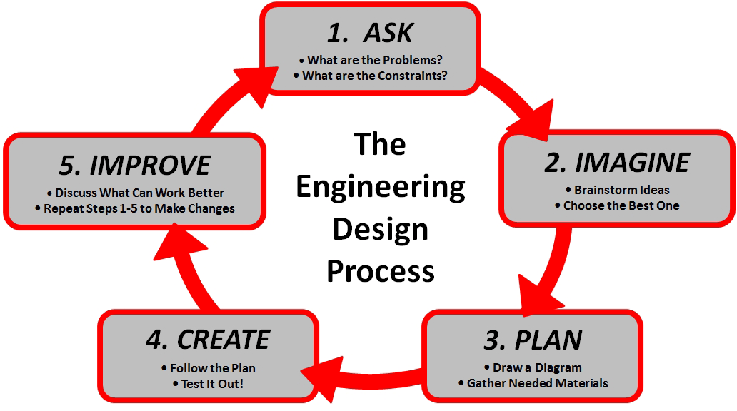
Structured Design Process
With a defined process has clearly defined phases
A good process is iterative:
  No one gets everything right the first time.

Slide 10
Development Sequence
Strategy
Define problem
Set priorities
Choose direction
The higher levels make little to no difference if you fail to achieve success at the next level down.
Choosing a great design is irrelevant if you cannot build it or control it.
Each step is vital, but spending too much time in the early steps compromises the
later steps.
Design
Create detailed designs
CAD Models
Supporting math
Fabrication
Make Parts
Create software
Integration
Assemble
Test, Develop
Tuning
Execution
Operate the Robot
Play the Game

Slide 11
Team Organizational Structure
Number of Sub-groups and
number of members per group
varies.
Project
Leader
Sub-team
Leader
Sub-team
Leader
Sub-team
Leader
Student
Leader
Student
Leader
Student
Leader
Student
Leader
Student
Student
Student
Student
Student
Student
Student
Student
Student
Student
Student
Student
Student
Student
Student
Student

Slide 12
Development V Model
Strategy
Practice
Overall Robot Objectives
Overall Robot Verification
Sub System
Design and Reqs
Sub System
Verification
Component
Design
Component
Verification
Implementation:
Make parts,
Assemble, code, wire, etc.

Slide 13
Objectives and Requirements at each level have different scope and are testable at that level.
Examples from 2015:
Strategic Level (Strategic Target)
- Robot must be able to build 3 capped stacks from the Landfill in a match.
- this can only be tested with a complete robot on a playing field.
Vehicle Level (Functional Objectives)
- Robot must be able to build a stack of 6 totes in 25 seconds or less.
- Robot must be able to obtain recycling containers from step without moving inverted totes while carrying 4 totes or more.
System Level (Design Requirements)
- Stacker Lift System must have a vertical lift speed of 4.5 ft/sec under maximum payload conditions ( 5 totes = 40 lbs. )
Sub System Level (Design Specifications)
- Lift Gearbox must have an output speed of 750 RPM at 40 in.lbs torque output
- Lift requires 35 lbs. of counter assist.
Component Level (Component Specs)
- Gearbox requires a 4:1 total ratio
- Lift motor must provide at least 300W peak power.

Slide 14
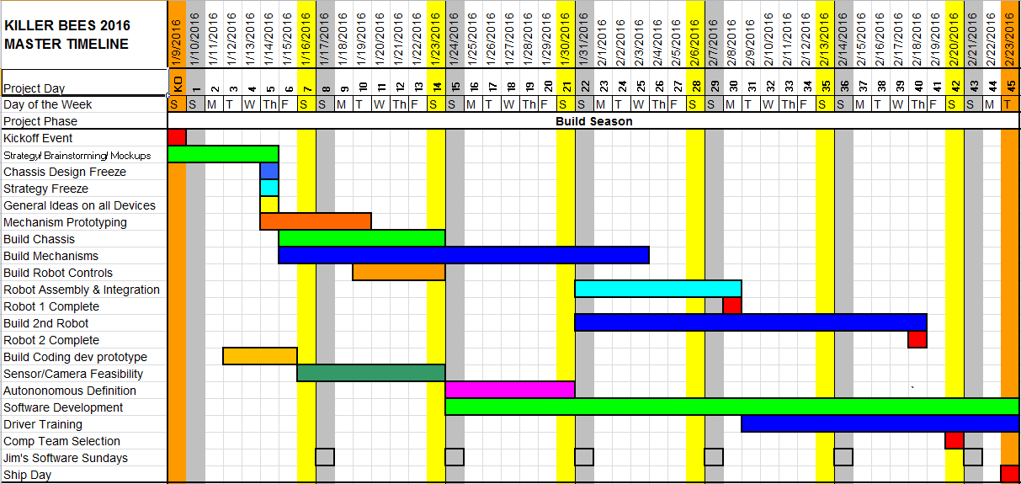
Make A Detailed Project Plan
This is very important! Someone MUST do this.
Define intermediate milestones for each part of the project.
Make a large copy of this plan and hang it on the wall.
Refer to it often. Admit you are late when you are late, not when time runs out!

Slide 15
Set Goals as a Team, Pick a Direction, and Go!
Analyze scoring and prioritize all possible robot tasks.
Make sure everyone knows the rules of the game! Consider having a pop quiz or a trivia contest.
Spend time strategizing and role playing, avoid jumping straight to machine design.
Get the whole team to understand and agree on the chosen direction! Later, if someone has a problem with the direction, you can always refer back to the original goals. This will prevent differences from becoming personal.
You should not spend more that a couple of days on strategy.
IMPORTANT: Picking an imperfect direction and figuring out how to enhance later it is almost always better than trying to change direction radically mid-season and then not getting done.

Slide 16
Put in the Time
It takes 20 hours a week or more for your team to do this properly.
Many teams simply do not commit enough time in order to succeed.
Plan for a lot of time, and you will not regret this.
FRC takes a lot of time, and everything always takes longer than you think it will.
You WILL run out of time. Accept this and plan for it.
Do not stop working on ‘bag day’: You can scale back but there is much still to do and you will lose team cohesion if you stop meeting regularly.
Our team keeps the following schedule during the build phase.
  4 hour evening meetings M,T,W, Th.
  2 hour design/leaders meeting Fr.
  8 hour meeting Sat.
  Online collaborative sessions: Sun
  These are our Scheduled times, actuals are often much more.

Slide 17
Benchmark, Research, and Collaborate
FIRST Robotics is much more open than it used to be.
Many teams share designs online, make how-to videos, and publish complete CAD models; often just a few days after kickoff.
These can be a great resource for new teams, since these experts are effectively doing a lot of your prototyping for you.
Do not be overly fixated on trying to come up with your own entirely unique idea; copy from the best when you can.
Even before kickoff, there is much opportunity to study robots.
Regardless of the game, there are many standard construction methods and materials in the FRC, so studying past robots is a great way to learn the best ways to build the next one.
FRCDesigns.com has a large CAD library of many winning robots.
Many teams will open share expertise and designs if you simply ask for help.

Slide 18
Know your Limits!
Polycarbonate = .05 lb/in3
6061 Alum = .1 lb/in3
4130 Steel = .3 lb/in3
Wood = .02 lb/in3
FIRST limits us in five main areas.
  Materials, Size, Cost, Weight, Time
Time and Weight are the big ones.
  Time and weight tend to be inversely proportional:
    Lightweight solutions take longer to design and build.
  Use steel sparingly, check weight status often.
  Use tube and sheet instead of solid sections where ever possible.
  Keep CG as low as possible. Battery = 10%
  Never make complicated items which can be bought.
K.I.S.S. - Precision and complexity kill.
  Avoid needless precision, most robot elements don’t need to be very precise. Exacting precision costs time and generally forces students out of the process, wasting precious manpower.
  Once you have your initial idea for a design, have a brief brainstorming session to discuss ways to make it simpler and lighter before you start cutting metal.

Slide 19
Students are an Asset - Use Them!
High School students are capable of doing virtually any task related to your team with a little training and leadership. Never underestimate them.
If you think something can’t be done by students, always ask yourself; “Why not?” and “What can be done to enable them to do it?”
In the end the students get more out if they put more in. Remember, we are here for their benefit, they are the reason for all of this.
The more they can do, the more they will do (and thus the less adults have to do.)
In time, you will develop student leaders as capable and dedicated as any adult.

Slide 20
Mock It Up!
Mockups bridge the gap between concept and reality. 3-D objects convey ideas more effectively than sketches or CAD drawings. They make ideas flow.
Often, the requirements of a feature or mechanism must be found experimentally. This is impossible without some quick way to try out your ideas and determine what is important and what is not.
Interacting with game pieces and field elements are prime focus areas for mockups.
Wood, foam-board, cardboard, Lego, and old robots are great media for experimentation.
If your mockup takes more than a few days start to finish, it is too complex.
Students can assist more easily mockups than with paper designs.
Once the design is fine tuned, the “real one” can be made quickly and with confidence.

Slide 21
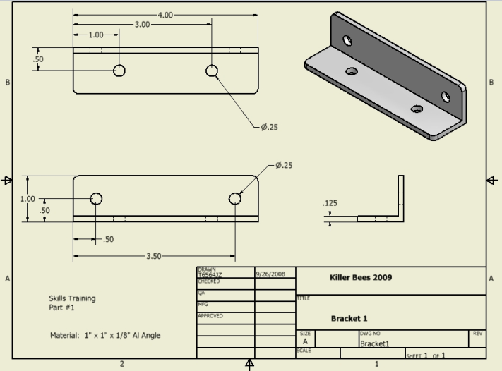
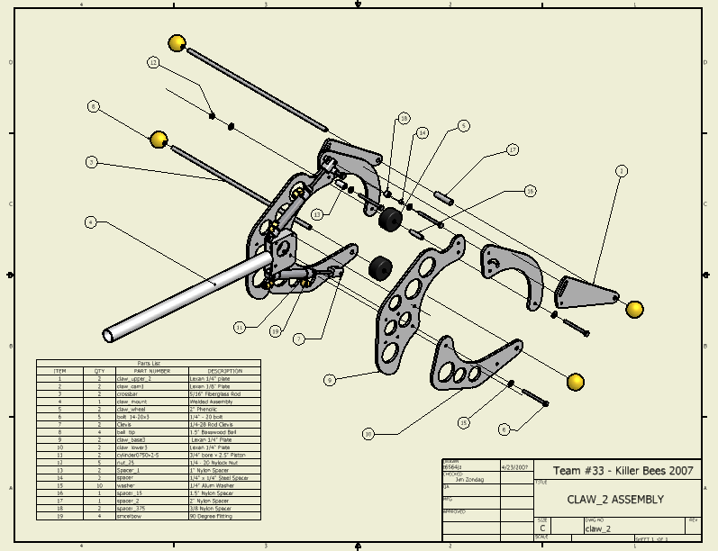
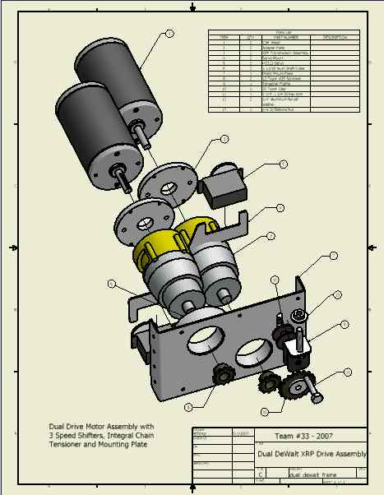
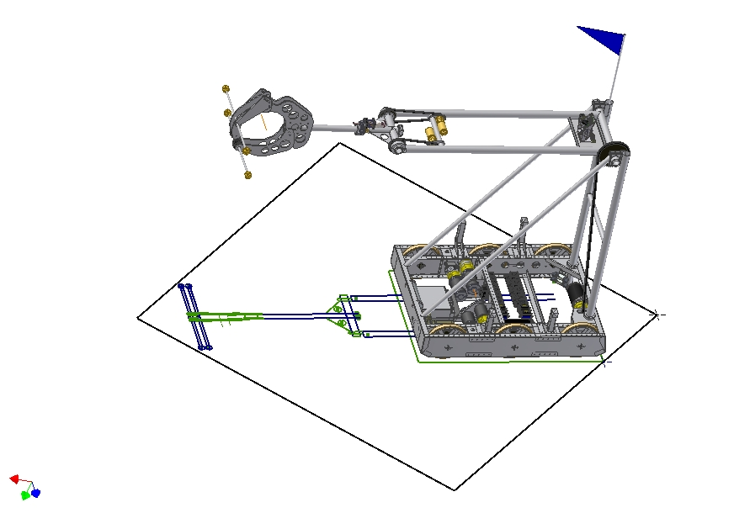
Make CAD drawing of all parts:
Indispensable for:
Design discussions
Part Manufacturing
Component packaging
Award Submissions
Technical Papers
This should be a team effort!
If you don’t know CAD, make paper drawings.
Then find a way to learn CAD, you will not regret this!

Slide 22
Modularize Your Design!
Break your robot into several main functional sub systems (chassis, arm, claw, etc.) and have a subgroup and leader for each one.
Try to define the size, weight, resource, and functional requirements of each section as thoroughly as possible.
Allocate manpower and resources to the subgroups according to the priorities established during goal setting.
Avoid thinking “ that’s their problem” or “our part is more important” of the other groups, you are all on the same team.
Have daily summary meetings with each group.
Someone MUST be an overseer over the whole project or you will face serious integration issues late in the project.

Slide 23
Do the Math!
A few quick calculations on any design are necessary before beginning to build to insure success. It only takes a few minutes and will save many hours of frustration. Figure out how fast it will move, how much it can lift, etc.
Doing the math is a great way to expose your students to the difference between engineering and tinkering. Most of them will never have seen this done before.
Always check your numbers on gear/chain ratios against motor speed, torque, and power specs. There are many great resources and calculators in CD white papers.
Check shear forces on critical joints, tension on chains, etc. They are often higher than you think.
Avoid pushing your luck, design in some safety margins. Robots have a way of degrading with use.

Slide 24
Get it Moving!
The sooner your chassis runs the better off you are. If you are new to FIRST, use the KIT Chassis!
“Half the game is just getting there!”
Most major robot failures are chassis related. You need to prove it out and beat it up. Test drive it often, on carpet and with ballast representative of final robot weight.
Having something moving helps eliminate the “week 4 blues”. Once your robot begins to move it stops being a pile of parts and takes on a life of its own in the minds of the team. Renewed enthusiasm will result.
Drivers need to train if you expect them to win. There is no substitute for practice.
If needed, schedule drive practice apart from build meetings.
Basic Limits: Robots should always be geared to move between 4 ft/s to 16 ft/s. Your exact speed choice will be determined by the game design.

Slide 25
Electrical - Neatness Counts
Neatness = Reliability and Reparability
Most sudden unexpected and “ghost” type problems tend to be electrical in nature.
Many electrical repairs are done under panic conditions. When quick trouble shooting is needed, it must be obvious what is what, what goes where, and what looks out of place.
Label, Label, Label, Document, Document, Document.
Strain relieve wire connections, hot glue your PWM connectors.
Do it right once and then leave it alone.
Students can do any and all your electrical jobs.
Tip: Robots with messy wiring NEVER win tech awards.

Slide 26
Controls Make the Difference
Intuitive, easy to use driver controls often make the difference between a good robot and great robot.
As soon as you decide on a mechanism, immediately ask yourself “ how will the driver control this?”
Having to look down at the controls can be a game killer.
Automated and semi-automated features simplify operation and allow drivers to train quickly. Having a robot that is easy to drive can help make up for lack of practice.
Mechanical design must be sound for good controllability. Controls can only enhance functionality.
You must build time into your schedule to do iterative tuning of your systems once the robot is built. Do not expect to be able to do this in the last few days.
Do not chase the controls ‘red herring’. FIRST likes to put these in the game design, but they are almost always a poor investment.
Feedback loops are a beautiful thing.

Slide 27
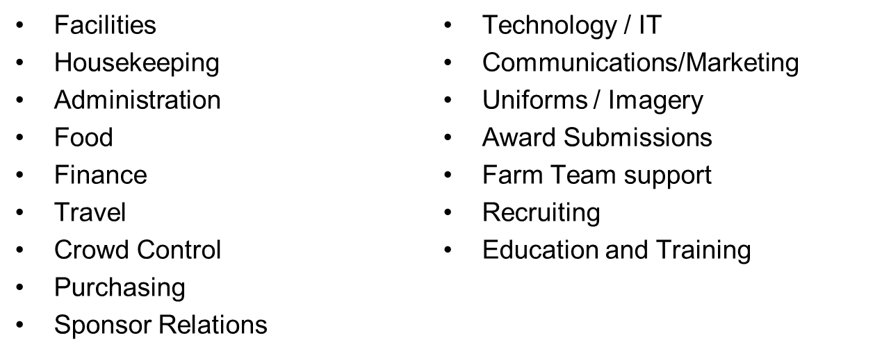
Team Leader Roles and Responsibilities
At the heart of every great team is at least one person who brings it all together. This person does much more than just design and build robots.
Running a FIRST team is a lot like running a small business, and the leader must wear many hats, including:
Tip: Getting help with the small stuff is the key to getting the big stuff done properly (and keeping your sanity).

Slide 28

Show Up: We are a team. To be a part of the team you need to be here, and be on time.
Speak Up: Communication is the key to teamwork. Your ideas matter and we want to hear them.
Listen Up: There is a time to talk and a time to listen; know the difference.
Smarten Up: The goal of our program is to make you smarter. Aggressively learn as much as you can.
Step Up: Take charge of your work and become a valued member of the team. Good work benefits the entire team.

Slide 29
6. Grow Up: Everyone on the team is an adult, we will treat you as adults as long as you act like adults.
7. Clean Up: Our workspace is our home. We all need to work together to keep it clean, safe, and productive.
8. Hurry Up: Time is our scarcest resource. Take the time to do good work, but get things done quickly.
9. Live It Up: Robotics is hard work, and hard work is fun. Enjoy every moment because it doesn’t get better than this.
10. Never Give Up: The Killer Bees are great because we never stop trying to improve. We can never lose if we never give up!

Slide 30
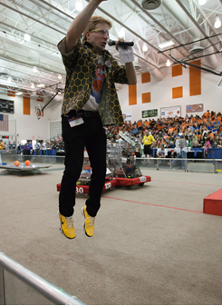
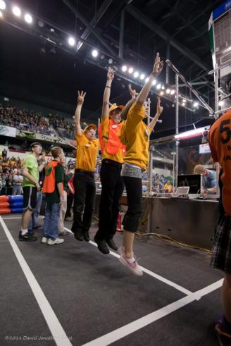
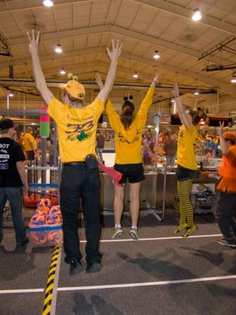

FIRST Robotics:
So much fun that sometimes we can defy gravity!

Slide 31


Questions?
(and hopefully some Answers)
Email 33killerbees@gmail.com
Website www.killerbees33.com
Twitter @FRC33

